Slide 1



Governance Risk and Compliance
Understand cyber risk to drive strategic security decision-making.
Notes:
• • Hook Slide: A key introductory slide that explains why you’re there and what outcome your prospect is seeking.

Slide 2

1980s-Early 2000s:
Mid-2000s to Early 2010s:
2015-2020:
The Foundations of
Cyber Regulation
Expanding Regulatory Focus on Cybersecurity
Cyber Attacks Drive Stricter Regulations
The Morris Worm: One of the first computer worms to spread across the internet, causing widespread disruption.
TJX Data Breach: One of the first large-scale retail breaches, exposing 45+ million credit card numbers.
SolarWinds Attack: A nation-state attack compromised U.S. gov. agencies and private companies, showing the dangers of supply chain vulnerabilities.
2021-Present
Businesses are operating in a different era.
Compliance Becomes a Business Imperative
Colonial Pipeline Ransomware Attack: A major ransomware attack disrupted fuel supplies on the U.S. East Coast, prompting executive actions on cybersecurity.
Notes:
Shift Slide: Name a Big, Relevant Change in the World
Don’t kick off a sales presentation by talking about your product, your headquarters locations, your investors, your clients, or anything about yourself. Instead, name the undeniable shift in the world that creates both (a) big stakes and (b) huge urgency for your prospect.

Slide 3
Cybersecurity compliance has evolved from optional best practices to mandatory business requirements.
Regulations like [insert relevant standard(s)] are tightening and expanding enforcement—and financial, legal, and reputational consequences are greater than ever.
Notes:
• • Pain Slide: A quick reminder of the problem they’re trying to solve (ideally, in their own words).

Slide 4
Nearly 65% of organizations report being expected to demonstrate compliance
Close to two-thirds (65%) of organizations say that customers, investors, and suppliers increasingly require demonstration of compliance
- State of Trust Report 2024 (Vanta)
You can either use compliance as a strategic business enabler…
33%
of companies say the primary focus
of their GRC program is rep
79% of compliance professionals are dedicated to providing greater visibility to senior management
- 2024 Exploring Strategic Compliance: The Next Frontier (FloQast)
Notes:
Show There’ll Be Winners and Losers
All prospects suffer from what economists call “loss aversion.” That is, they tend to avoid a possible loss by sticking to the status quo, rather than risk a possible gain by opting for change.
To combat loss aversion, you must demonstrate how the change you cited above will create big winners and big losers. In other words, you have to show both of the following:
That adapting to the change you cited will likely result in a highly positive future for the prospect; and
That not doing so will likely result in an unacceptably negative future for the prospect (Next slide)
https://www.vanta.com/state-of-trust
https://www.globenewswire.com/news-release/2024/09/18/2948251/0/en/Survey-Only-16-of-Organizations-are-Approaching-the-Next-Frontier-of-Compliance.html

Slide 5
In 2019, Equifax agreed to pay (at least) $575 Million
in a settlement with the FTC, the CFPB, and all 50 U.S. states and territories over the company’s “failure to take reasonable steps to secure its network.”
- csoonline.com
Or you can gamble with increased likelihood of a breach, potential fines, and legal exposure.
25% higher chance of experiencing a breach
In 2024, companies managing their IT risks ad-hoc had a 25% higher chance of experiencing a breach than those that took an integrated approach.
- 2025 IT Risk and Compliance Benchmark Report (Hyperproof)
Notes:
https://www.csoonline.com/article/567531/the-biggest-data-breach-fines-penalties-and-settlements-so-far.html
https://learn.hyperproof.io/hubfs/PDF%20Downloads/2025-Spring-Benchmark-Report_Hyperproof.pdf

Slide 6




Gain a competitive advantage with a structured approach to GRC
Companies that embrace compliance as a strategic advantage will thrive. Their security posture will be stronger, their risk exposure lower, and their ability to do business—without regulatory roadblocks—will only improve.
Confidence &
control
Proactive
Evolution
Business growth opportunities
Compliance becomes predictable and repeatable, not a last-minute scramble. Plus, it helps reduce your over all risk to cyber incidents.
Strategically and proactively evolve your defenses by incorporating expert human oversight into operational security to stay ahead of advanced threats.
Customers, partners, and stakeholders trust organizations with a mature security posture, leading to faster deal approvals and stronger market positioning.
Notes:
• • Value Slide: Show them what’s possible and what achieving this outcome would be worth to them.

Slide 7



Simplified GRC at Your Fingertips
Sophisticated evidence collection
Risk
visibility
Strategic cyber guidance
Documentation for audits, insurance, and governing boards.
Detailed reports for data-driven decision making and progress tracking.
Advice and oversight from certified cybersecurity professionals.
Notes:
“Promised land” teaser If you introduce product/service details too soon, prospects won’t yet have enough context for why those details are important, and they’ll tune out.
Instead, first present a “teaser” vision of the happily-ever-after that your product/service will help the prospect achieve––The Promised Land

Slide 8






Define, manage, and optimize Your Security program
Compliance management
vCISO consultation
Find gaps, prepare a plan to close them, and manage execution.
Expert cyber guidance on critical security functions.
Risk analysis & mitigation
Detailed reporting
Full assessment of your risk and posture compared to industry benchmarks.
High-level dashboard analytics and comprehensive data-driven reports.
Security road mapping
Policy library
Detailed remediation plan with tasks ranked by level of criticality.
40+ set of actionable policies adjusted to your specific needs and requirements.
Notes:
• • Solution Slide: Provide an overview of how exactly you can bring the prospect value and solve their problems.

Slide 9
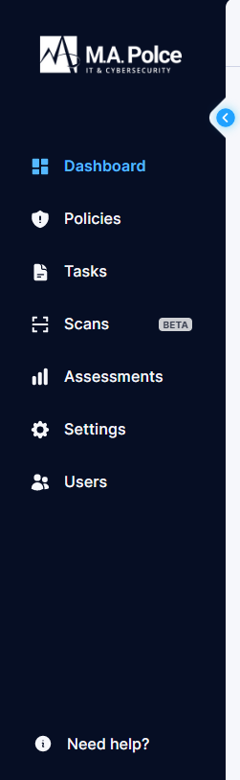
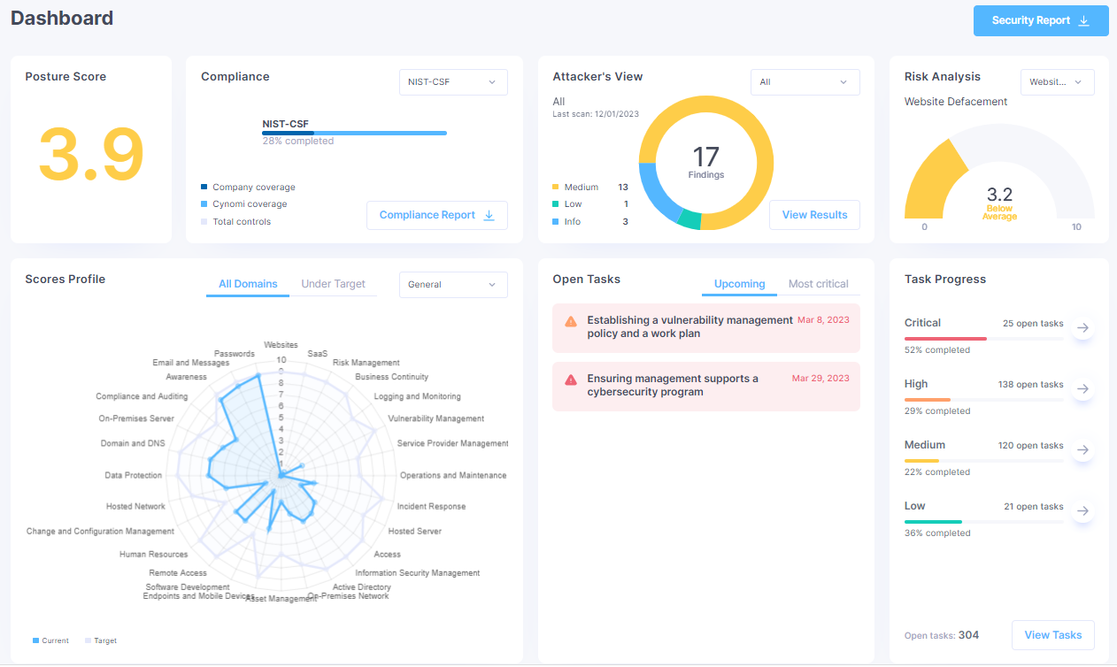
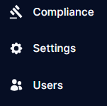
Dashboard Visibility
High-level analytics
Upcoming roadmap items
Notes:
Reframe: this is how we quantify it so its no longer nebulous, drive with numbers and data

Slide 10
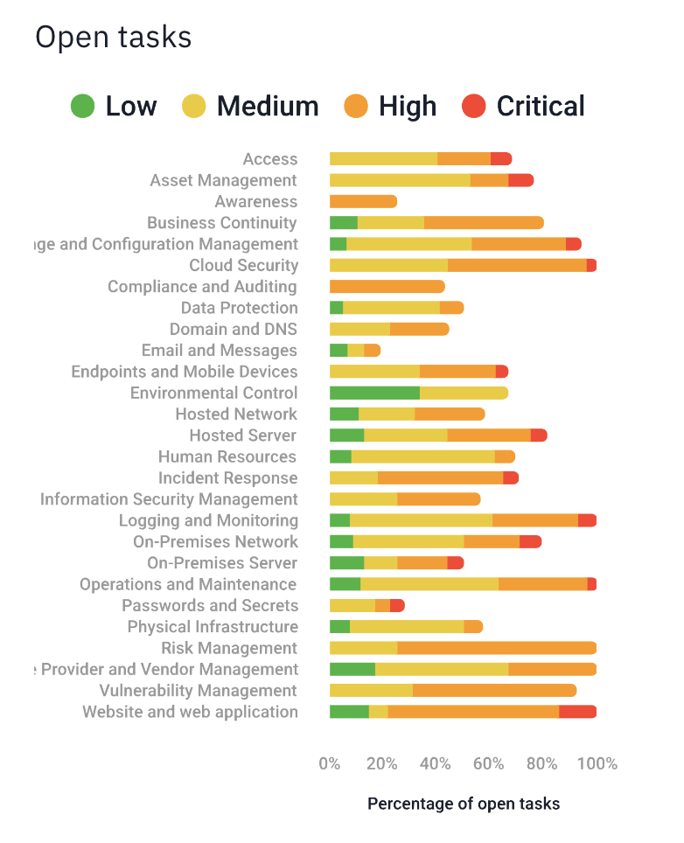
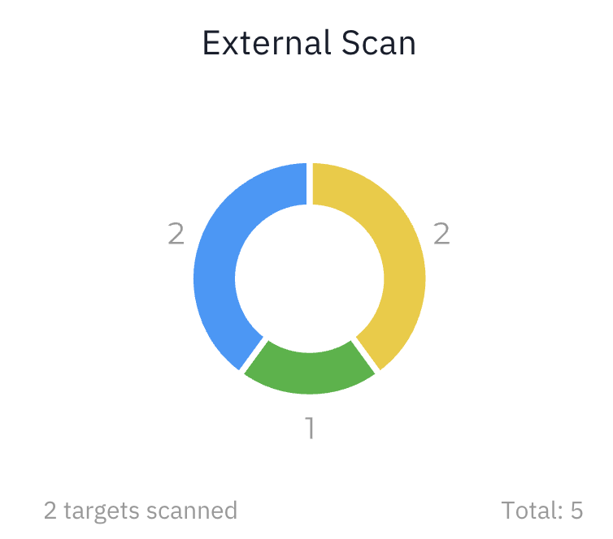
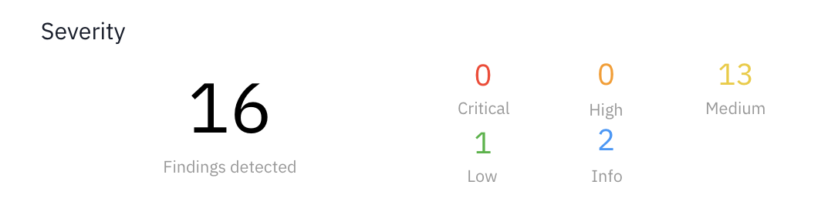
FEATURES
Data Driven Reports
Report types
Compliance Report (Gap Analysis)
Risk Snapshot Report (Scan Results)
Cybersecurity Analysis Report (Full Report w/ Roadmap)
Use cases for reports:
Auditors
Governing Boards
Senior Administration
Agency Reporting
Insurance
Notes:
• • Pain Slide: A quick reminder of the problem they’re trying to solve (ideally, in their own words).

Slide 11
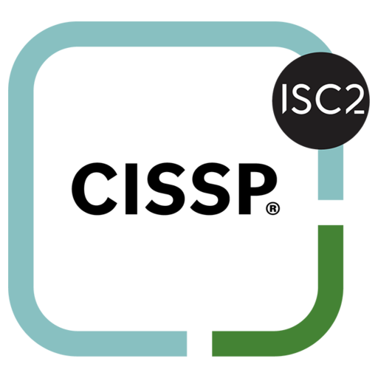
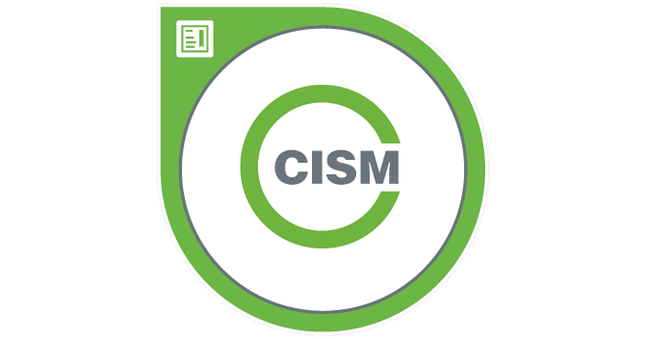
FEATURES
vCISO Consultation
Access the expertise, strategic guidance, and proactive management of a Chief Information Security Officer (CISO) without the cost of a full-time hire.
Leverage security expertise for things like:
Policy and plan development
Security road mapping
Risk management and governance
Compliance and regulatory support
Prioritizing security investments based on risk tolerance
General guidance on critical security functions
Strategizing and sharing ideas
Notes:
• • Options Slide Outline each option you have alongside desired outcomes, pricing, and differentiating factors.

Slide 12


CHALLENGE
CASE STUDY
A large suburban school district had security tools but lacked a comprehensive strategy for compliance, risk, and assessment, prioritizing daily IT tasks over long-term security planning.
Client Profile
Business: Suburban School District
Size: 600 employees – 3,000 students
Client Challenges: NIST-CSF
SOLUTION
Key Metrics
We conducted an onboarding assessment to generate a risk baseline and NIST-CSF-aligned roadmap. A certified vCISO coordinated all efforts through monthly meetings, supported by an AI-driven platform for reporting and roadmap alignment.
Data speaks louder than words, so we selected a few points of interest to help tell the story:
47
Critical security tasks identified and remediated
300+
RESULTS
NIST controls aligned
Internal Communication Enhancements
Security Posture Strengthening
Security Deployment Visibility
Notes:
• • Social Proof Slide: How others have achieved their goals through your product or service.

Slide 13


Core
Base
Plus
vCISO
Custom Roadmap
Potential program builds
AI-Risk Analysis
Monthly Reports
Policy Library Access
Monthly External Scans
Internal Vulnerability Scans
Penetration Testing
Tabletop Exercise
Remediation Hours
Notes:
• • Options Slide Outline each option you have alongside desired outcomes, pricing, and differentiating factors.
Just ideas, you can do what ever you want, make

Slide 14



Thank you
Questions?
800-610-1858
info@stactive.com
stactive.com
Notes:
Call to action slide: get the prospect to take the next step

